Slide 1
What’s New in Configuration Manager
LouMug
July 2019

Slide 2
About Me
Tony Morrow
Principal Solutions Architect
Bellarmine University
amorrow@bellarmine.edu
10 years working at Bellarmine
Focus
Networking
Wireless
Servers/Virtualization
Systems Integration
Problem Solving
PowerShell, PowerShell, PowerShell

Slide 3
Disclaimer (joke)
I am not a Microsoft MVP or Partner
I have no inside knowledge of Microsoft or Configuration Manager
Bellarmine has paid licenses for Configuration Manager
All the opinions here are my own
Nobody is paying me for this presentation
Nobody has reviewed or approved this presentation before hand

Slide 4
Topics
What is Configuration Manager?
What has changed when compared to 2012?
What’s new in Configuration Manager 1902?
How Bellarmine uses Configuration Manager
Tips and Suggestions
Demos

Slide 5
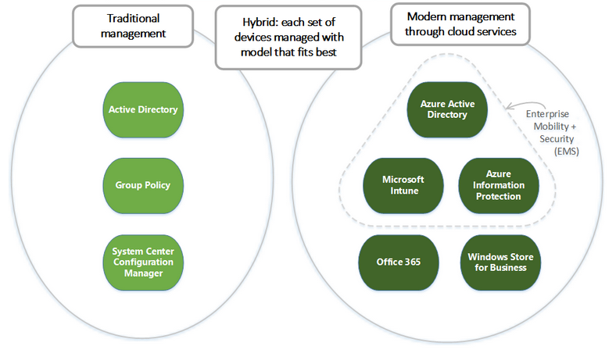
What is Configuration Manager?
A product in the Microsoft System Center suite of management solutions, System Center Configuration Manager can help you manage devices and users both on-premises and in the cloud*.
“Traditional management model”
On-prem
Big application
SQL
IIS
ADK
WDS
WSUS
PKI
Notes:
https://docs.microsoft.com/en-us/sccm/core/understand/introduction
https://docs.microsoft.com/en-us/windows/client-management/manage-windows-10-in-your-organization-modern-management

Slide 6
What can Configuration Manager do?
Deploy software to client systems
Deploy Windows Updates in a more granular fashion compared to WSUS auto approval rules
Manage Windows Imaging from start to finish
Manage Windows Defender/Endpoint Protection
Define and remediate compliance rules on clients
Collect PC information and generate reports

Slide 7
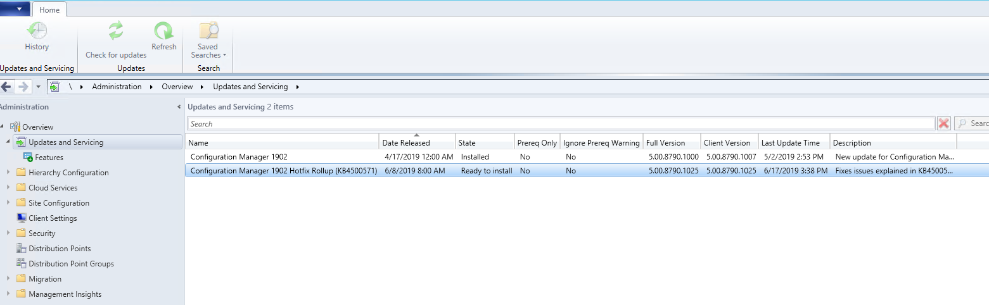
What has changed when compared to 2012?
A lot!
Simpler upgrade structure (1511)
New features released 3 times a year
18 months of support from day of release
Upgrades performed through the console
No more hunting down the correct ISO
No more 2012 SP1 CU5 vs 2012 R2 CU5 vs 2012 SP2 CU4 vs 2012 R2 SP1 CU4
Now: 1511 →1602 →1606 →1610 →1702 →1706 →1010 →1802 →1806 →1810 →1902 →1906

Slide 8
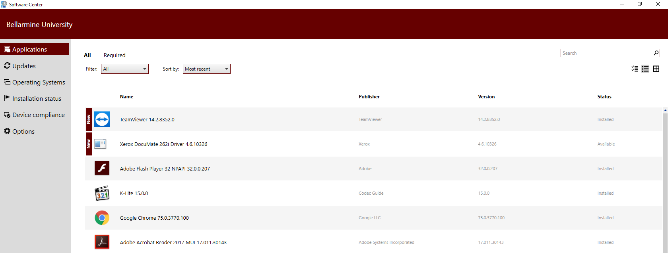
What has changed when compared to 2012?
New Software Center for clients (1511)

Slide 9
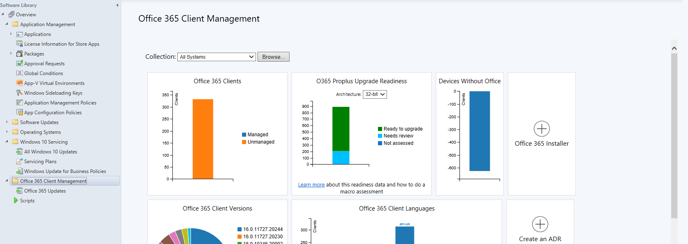
What has changed when compared to 2012?
Office365 client installation and update management (1610)

Slide 10
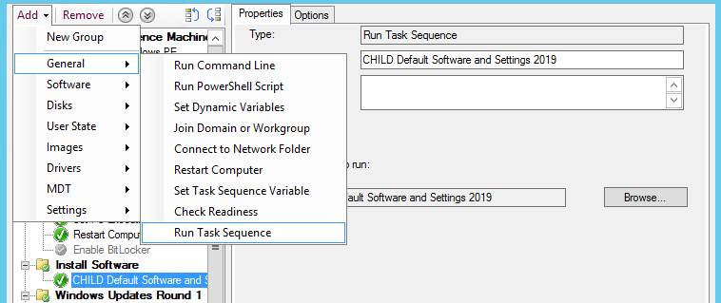
What has changed when compared to 2012?
CHILD TASK SEQUENCES!!!!!!!!!!!!!!!!!!!!!!!! (1710)

Slide 11
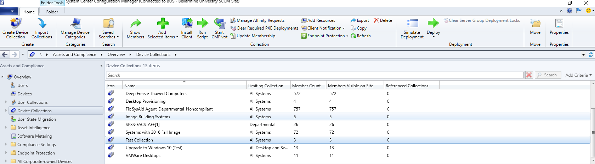
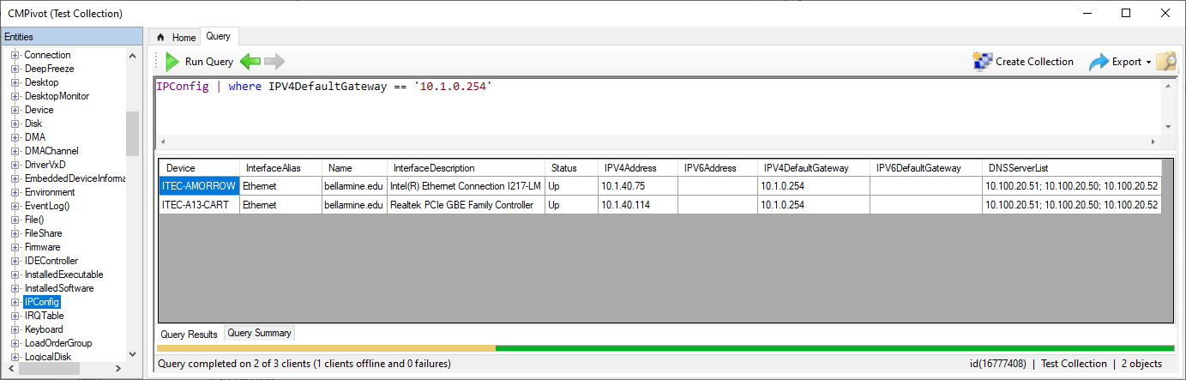
What has changed when compared to 2012?
Real-time management (1806)
New tool called CMPivot can execute against clients in real-time to retrieve information
Execute PowerShell scripts against clients in real-time

Slide 12
What has changed when compared to 2012?
Phased deployments for OS and application installation (1802/1806)
Usable PowerShell cmdlets (1511)
Convert packages to applications (1806)
Deploy Microsoft Store apps to clients (1606/1610/1702)
Manage iOS volume-purchased apps (1606)
New options for upgrading Windows 7/8.1 to 10 (1511/1602)

Slide 13
What has changed when compared to 2012?
Windows Defender ATP integration (1606)
Manage Windows Defender App Guard (1710)
Cloud management gateway for Internet-based clients (1610)
Improved compliance rule building and remediation (1511)
Windows 10 ARM support (1710)

Slide 14
What’s new in Configuration Manager 1902?

Slide 15
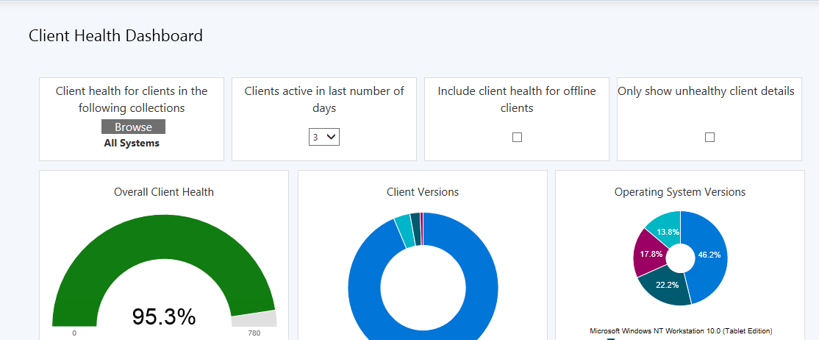
What’s new in Configuration Manager 1902?
New Client Health Dashboard

Slide 16
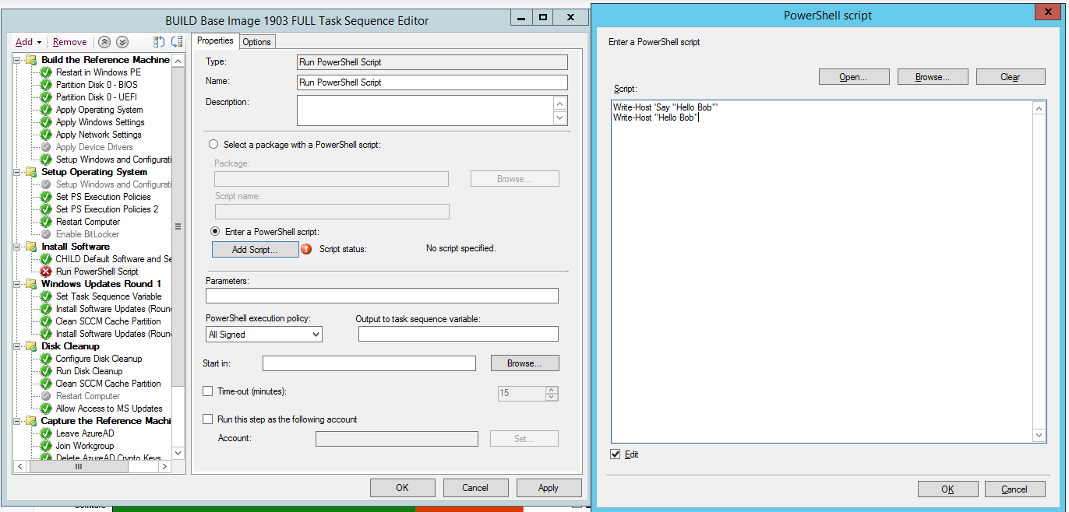
What’s new in Configuration Manager 1902?
Directly enter PowerShell code in a task sequence step

Slide 17
What’s new in Configuration Manager 1902?
Client provisioning mode timeout
Replace client toast notifications with intrusive dialog boxes
Use ConfigMgr to redirect known folder to OneDrive

Slide 18
How Bellarmine uses Configuration Manager
Brief History:
Using Configuration Manager since 2011
Started with Configuration Manager 2007 and used it up to the end of 2015
Transitioned to Configuration Manager (Current Branch) in early 2016
Upgrade every 4-8 months to the latest feature update (just like Windows and Office 365)

Slide 19
How Bellarmine uses Configuration Manager
Bellarmine’s Configuration Manager Environment
Clients:
~1500 managed Windows desktops and laptops
~175 managed Windows servers
~4500 active users
Configuration Manager Servers
1x Windows Server 2012 R2
6 cores
16GB RAM
Almost 1TB of storage
Roles
Site Server
Management Point
Distribution Point
Database Server
Software Update Point
Reporting Server

Slide 20
What we use Configuration Manager for
Software Deployments and Updates
Build Applications instead of packages almost exclusively.
Icons in Software Center
Detection rule so installs don’t have to be re-run and possibly break something
Build new Applications every month for common software like Chrome, Flash, Firefox, etc.
Use PowerShell to help automate this process
Public computers install new software updates weekly
In the process of defining software updates for faculty/staff systems.

Slide 21
What we use Configuration Manager for
Desktop Imaging
Build fully customized “fat” images
Completely automated using task sequences
New out-of-box systems are PXE booted and imaged
Public use computers can be reimaged on demand or automated.
Standard “public” image take 1-2 hours to install
OS Upgrades
New feature of Configuration Manager
In place upgrade of Windows
Doesn’t affect user profile or existing applications
Process still being debugged
Intel video drivers and System Center Endpoint Protection are the two most common problems

Slide 22
How Bellarmine uses Configuration Manager
Server OS Patching
Updates downloaded and deployed using Automatic Deployment Rules
Install happens at defined maintenance window
ERP: Every 3 months on the 4th Saturday
Everything Else: Every month on the 4th Sunday
June 2019 updates occurred on 6/23/2019
3 out of ~150 servers failed
2x failures attributed to install timeout of Server 2016 Cumulative Update
1x failure due to insufficient disk space

Slide 23
How Bellarmine uses Configuration Manager
Reports
More for myself than IT
Uses SQL Server Reporting Services
ANYTHING in the Configuration Manager database can be surfaced%

Slide 24
Tips and Suggestions

Slide 25
Tips and Suggestions
Embrace automation
Use WQL queries to populate collections
Use PowerShell to execute repetitive tasks
Automate Software Updates
Don’t be afraid to use “Required” deployments to install software or task sequences

Slide 26
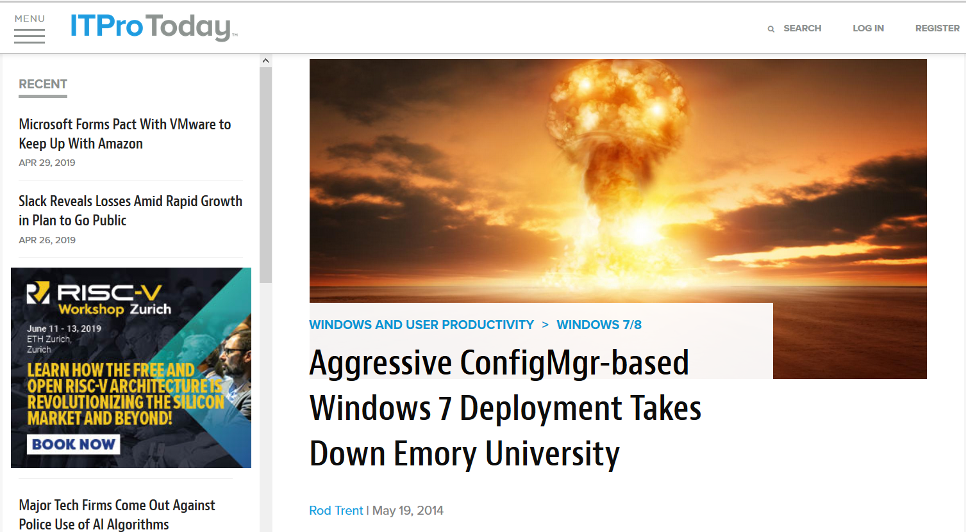
Tips and Suggestions
Embrace automation

Slide 27
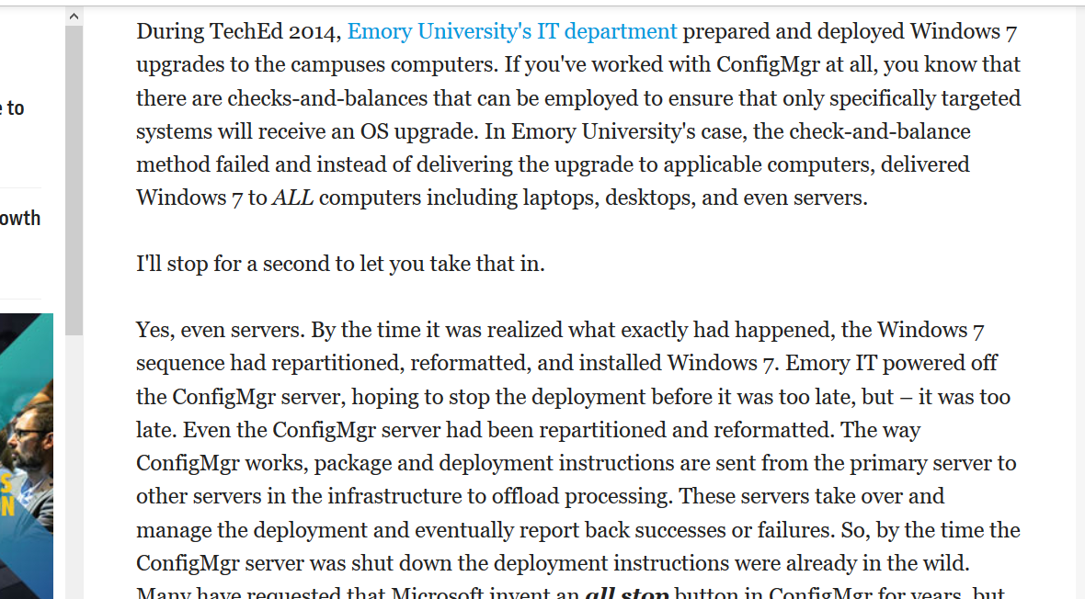
Tips and Suggestions
Embrace automation

Slide 28
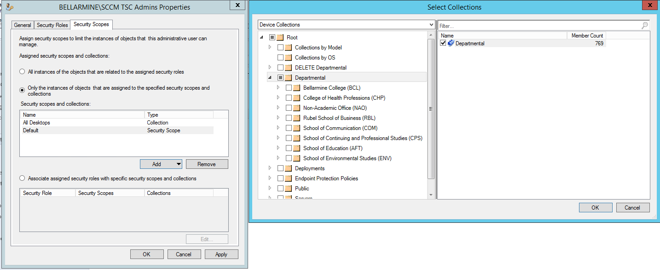
Tips and Suggestions
Trim and manage security permissions
If your desktop admins don’t need access to collections to servers, revoke access

Slide 29
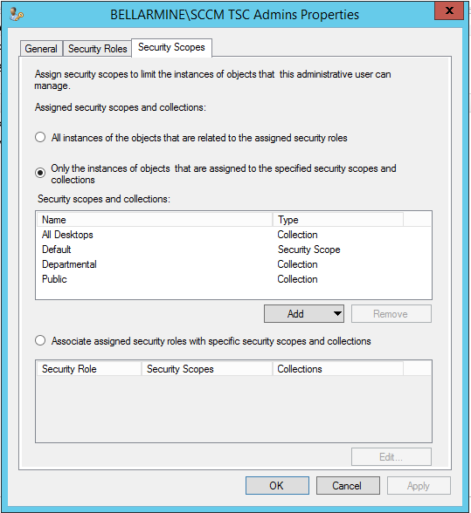
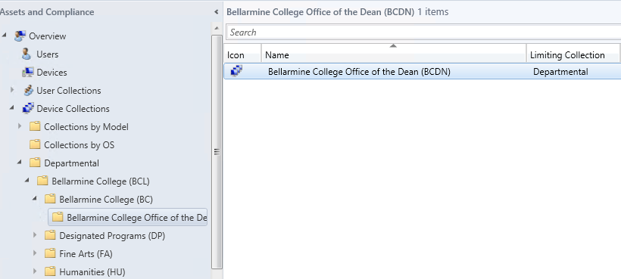
Tips and Suggestions
Trim and manage security permissions
“When an administrative user has permissions to a collection, they also have permissions to collections that are limited to that collection.”
Notes:
https://docs.microsoft.com/en-us/sccm/core/servers/deploy/configure/configure-role-based-administration

Slide 30
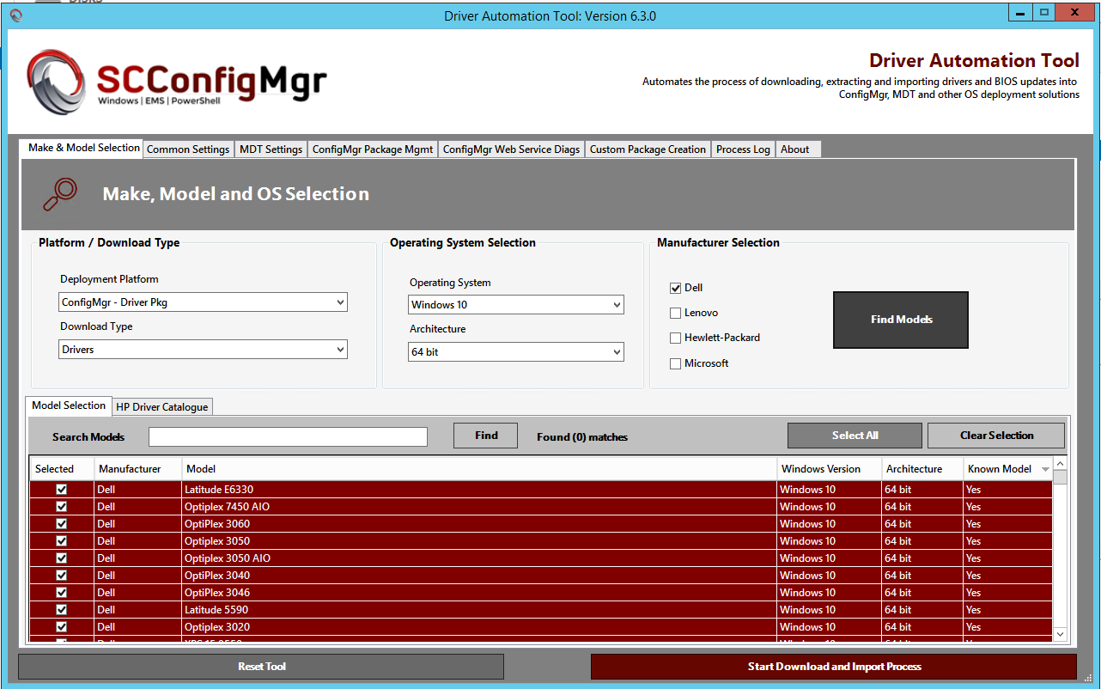
Tips and Suggestions
Use SCConfigMgr Driver Automation Tool to get out of the driver nightmare
Notes:
https://www.scconfigmgr.com/modern-driver-management

Slide 31
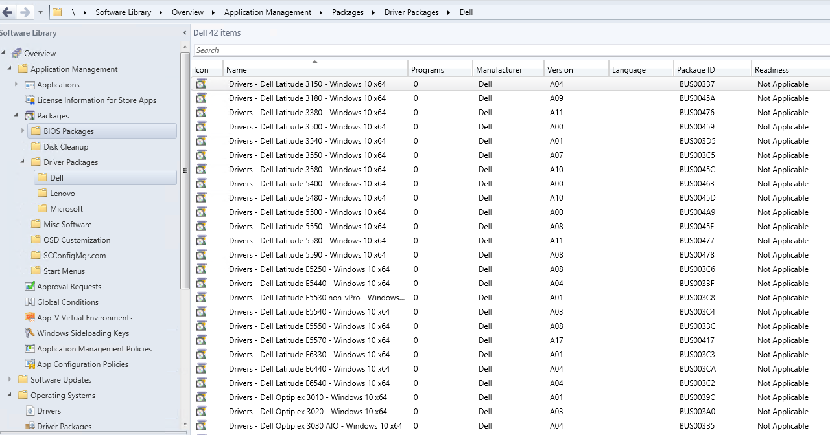
Tips and Suggestions
Use SCConfigMgr Driver Automation Tool to get out of the driver nightmare
Notes:
https://www.scconfigmgr.com/modern-driver-management

Slide 32
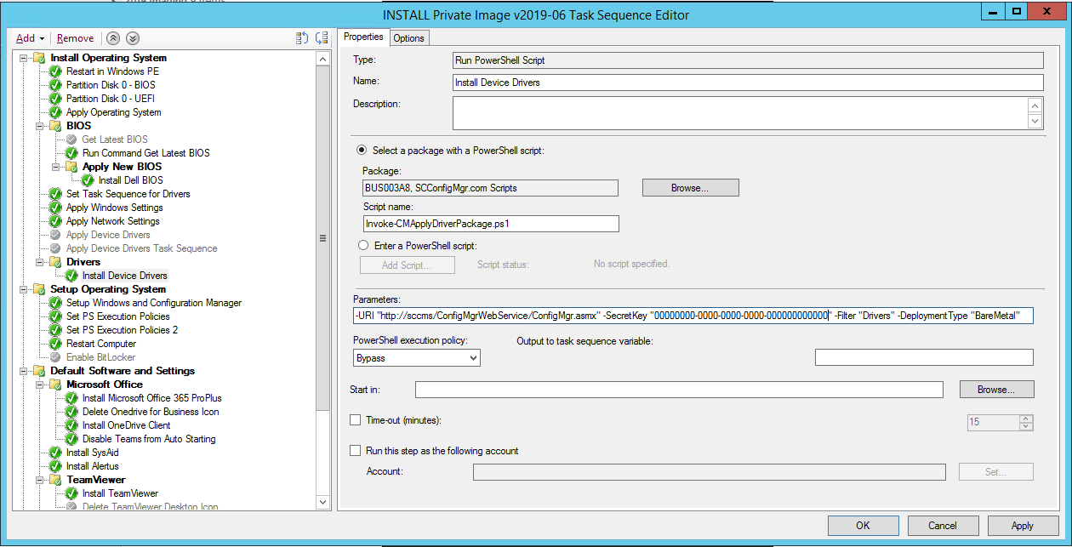
Tips and Suggestions
Use SCConfigMgr Driver Automation Tool to get out of the driver nightmare
Notes:
https://www.scconfigmgr.com/modern-driver-management

Slide 33
Tips and Suggestions
Dedup your distribution points, migration points, software source, and driver sources
No really, it’s okay¹
We see 47% savings on the DP disk
78% savings on disk that holds image captures & drivers
Notes:
1. https://techcommunity.microsoft.com/t5/Configuration-Manager-Archive/Configuration-Manager-Distribution-Points-and-Windows-Server/ba-p/273385

Slide 34
Demo and Examples

Slide 35
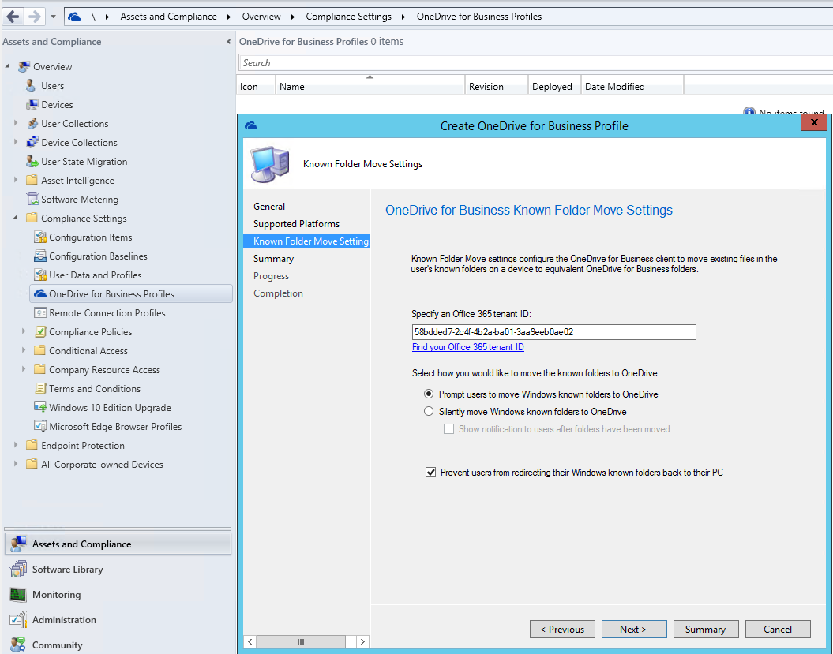
OneDrive Settings

Slide 36
Task Sequences: Child Task Sequences

Slide 37
Task Sequences: PowerShell

Slide 38
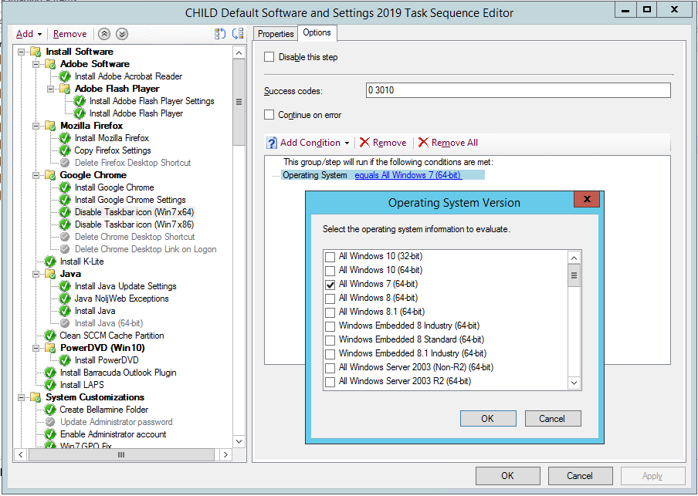
Task Sequences: Filtering (OS Version)

Slide 39
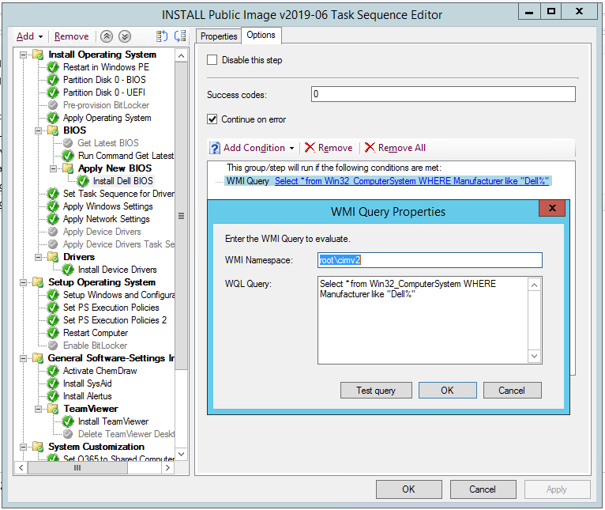
Task Sequences: Filtering (System Make)

Slide 40
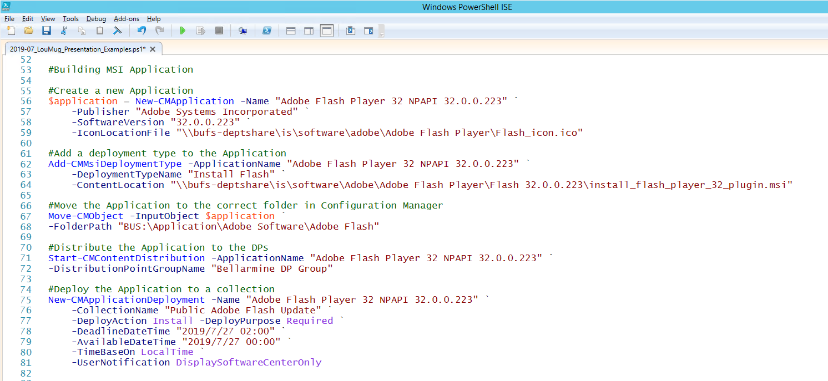

Slide 41
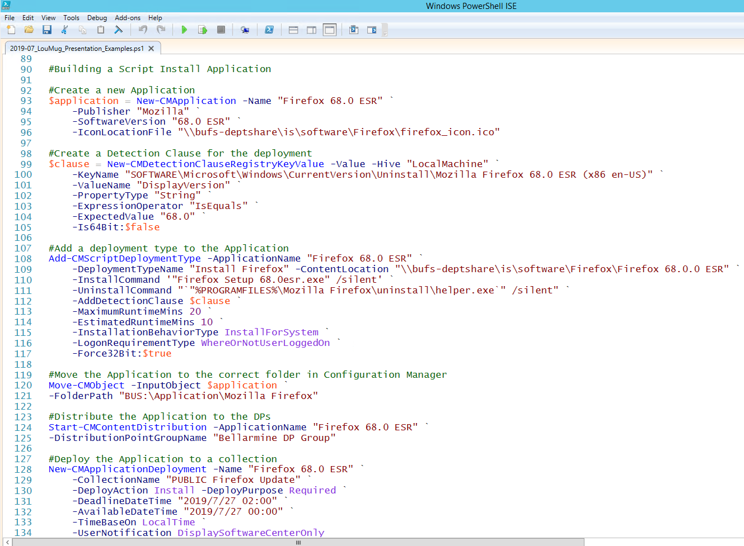

Slide 42
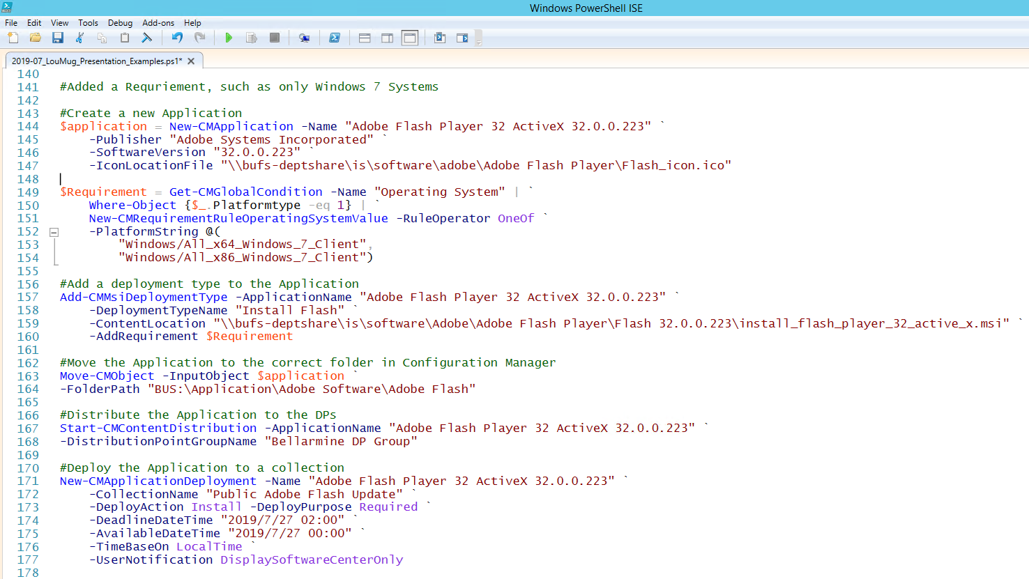

Slide 43
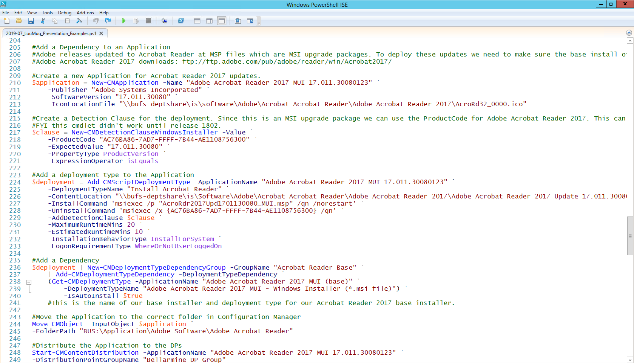

Slide 44
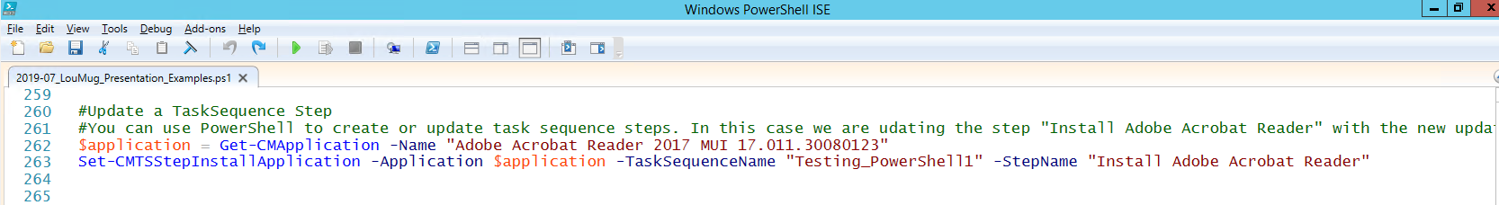

Slide 45
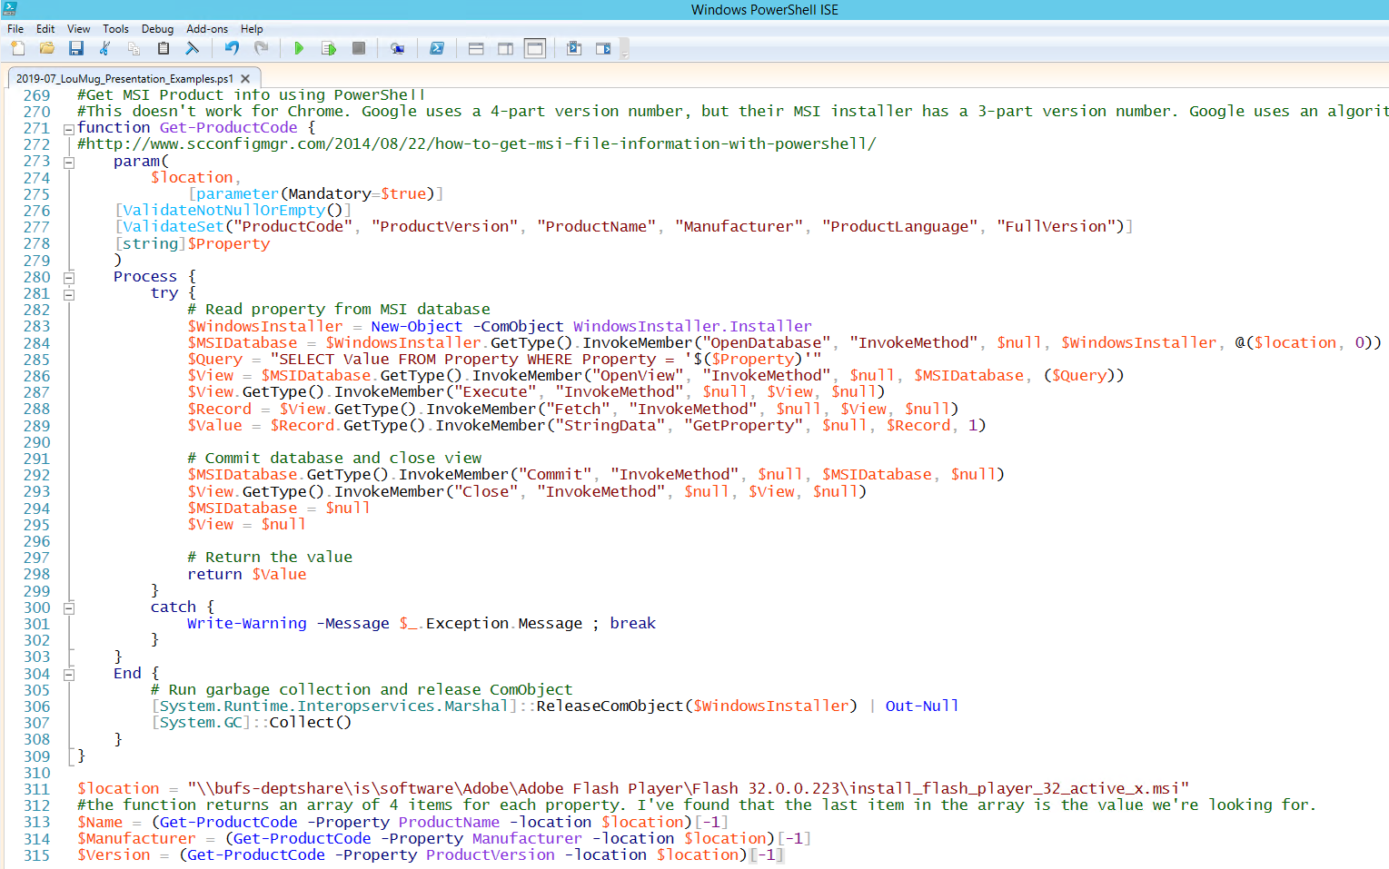

Slide 46
Resources
Prajwal Desai https://prajwaldesai.com/
https://prajwaldesai.com/sccm-2012-r2-step-by-step-guide/
https://www.prajwaldesai.com/sccm-current-branch-guides/
System Center Dudes https://www.systemcenterdudes.com/category/sccm/
https://www.systemcenterdudes.com/step-by-step-sccm-1802-upgrade-guide/
System Center ConfigMgr https://www.scconfigmgr.com/
http://www.scconfigmgr.com/driver-automation-tool/
https://www.scconfigmgr.com/modern-driver-management/
https://www.scconfigmgr.com/modern-bios-management/
Mikael Nystrom https://deploymentbunny.com
Johan Arwidmark https://deploymentresearch.com
https://docs.microsoft.com/en-us/sccm/

Slide 47
What’s New in Configuration Manager
Tony Morrow
Solutions Architect
Bellarmine University
amorrow@bellarmine.edu

